Slide 1
Fraud Detection Network Analysis
By Gopalakrishnan Kumar, MTech IIT-Bombay,
Freelance Data Science Consultant
LinkedIn: Profile Link : https://www.linkedin.com/in/gopalakrishnankumar-a73301110/
Github:https://github.com/Gopal21236/
Kaggle URL- https://www.kaggle.com/gopalkk2

Slide 2
Google Colab URL
https://colab.research.google.com/drive/1HVeuLKaJibCEIBjbCd8K41U7Tr1ILQXH?usp=sharing

Slide 3
Executive Summary
Financial institutions increasingly face sophisticated fraud involving collusion, mule accounts, and organized transaction networks. Traditional rule-based fraud detection systems struggle to detect such patterns due to their focus on individual transactions rather than relational behavior.
This project applies network analysis techniques to transaction data to uncover hidden fraud structures. By modeling customers as nodes and transactions as edges, the solution identifies suspicious hubs, intermediaries, and abnormal transaction patterns using graph analytics and visualization.

Slide 4
Business Problem
Fraud detection teams face the following challenges:
Inability to detect collusive fraud rings
High false positives from rule-based systems
Limited visibility into transaction relationships
Difficulty prioritizing investigations effectively
Without network-level analysis, fraud often remains undetected until losses accumulate.

Slide 5
Project Objectives
The objectives of this project are to:
Model financial transactions as a network graph
Identify suspicious accounts using network centrality metrics
Detect fraud patterns beyond single-transaction rules
Provide explainable, visual fraud insights
Enable better investigation prioritization

Slide 6
Data Description
The dataset consists of transaction-level records with:
Sender account
Receiver account
Transaction amount
Fraud label (Normal / Suspicious)
Each transaction represents a directed edge between two nodes.

Slide 7
Methodology
5.1 Network Construction
Customers are represented as nodes
Transactions are represented as directed edges
Edge weights capture transaction amounts
5.2 Network Metrics Used
Degree Centrality: Identifies highly active nodes
Betweenness Centrality: Identifies intermediary or mule accounts
PageRank: Measures influence within the network
These metrics help surface nodes that play critical roles in fraudulent flows.

Slide 8
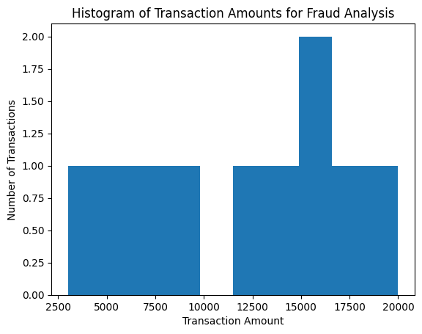
Data Visualization

Slide 9
Visualization and Analytics
6.1 Histogram Analysis
The histogram of transaction amounts highlights the distribution of transaction sizes.
Insight:
High-value outliers indicate potential fraud or coordinated fund movement.

Slide 10
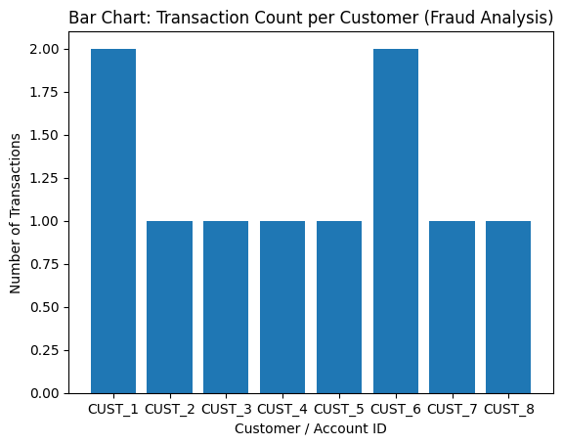
Data Visualization

Slide 11
Visualization and Analytics
6.2 Bar Chart Analysis
The bar chart shows the number of transactions per customer.
Insight:
Accounts with unusually high activity often act as transaction hubs or intermediaries.

Slide 12
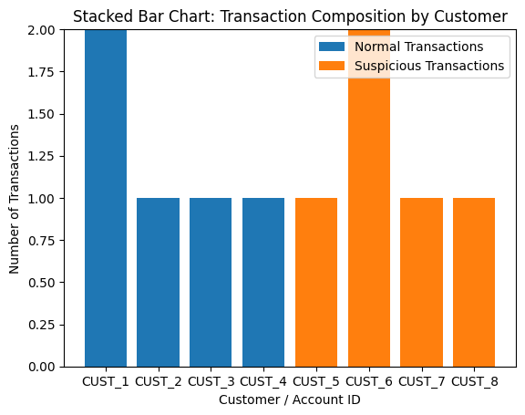
Data Visualization

Slide 13
Visualization and Analytics
6.3 Stacked Bar Chart Analysis
The stacked bar chart breaks transactions per customer into:
Normal transactions
Suspicious transactions
Insight:
Customers with a high proportion of suspicious transactions require immediate review.

Slide 14
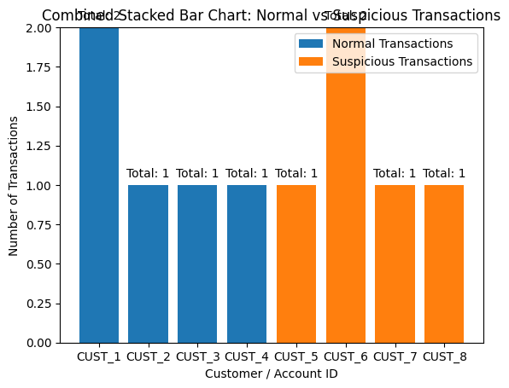
Data Visualization

Slide 15
Visualization and Analytics
6.4 Combined Stacked Bar Chart Analysis
The combined stacked bar chart shows:
Total transaction volume per customer
Composition of normal vs suspicious transactions
Annotated totals for executive clarity

Slide 16
Key Insights
Fraud often manifests as network patterns, not isolated
events
High betweenness nodes are strong fraud candidates
Transaction hubs frequently indicate mule accounts
Visualization significantly improves fraud explainability
Network analysis reduces false positives

Slide 17
Future Enhancements
Community detection for fraud rings
Temporal network analysis
Machine-learning-based fraud scoring
Real-time transaction monitoring
Dashboard integration

Slide 18
Conclusion
This project demonstrates how network analytics transforms fraud detection by uncovering hidden relationships and collusive behavior. By combining graph metrics with intuitive visualizations, the approach delivers explainable, scalable, and business-ready fraud insights aligned with modern financial risk management practices.

